Slide 1
Algebraic properties of matrices

Slide 2
Assuming that the sizes of the matrices are such that the indicated operations can be performed, the following rules of matrix arithmetic are valid:
A+ B = B+ A (commutative law for addition)
A+ (B + C) = (A +B) +C (associative law for addition)
A( B C) = (A B) C (associative law for multiplication)
A (B + C) = AB +AC (left distributive law)
(B+ C) A = BA + CA (right distributive law)
A (B – C) = AB – AC

Slide 3
(B – C) A = BA – CA
a(B +C) = aB + aC
a(B – C) = aB – aC
(a+b) C = aC + bC
(a-b) C = aC – bC
a(bC) = (ab) C
a(B C) = B (aC)

Slide 4
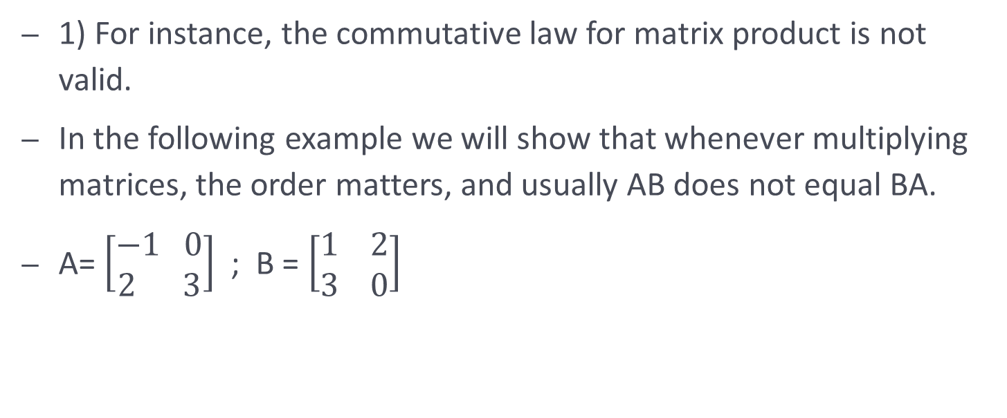
Important Note: Not all properties of arithmetic are true for matrices.
1) For instance, the commutative law for matrix product is not valid.
In the following example we will show that whenever multiplying matrices, the order matters, and usually AB does not equal BA.
A= $\left[\begin{aligned}−1 0 \\ 2 3\end{aligned}\right]$ ; B = $\left[\begin{aligned}1 2 \\ 3 0\end{aligned}\right]$

Slide 5

AB = $\left[\begin{aligned}−1 −2 \\ 11 4\end{aligned}\right]$
BA = $\left[\begin{aligned}3 6 \\ −3 0\end{aligned}\right]$
It can be observed that AB does not equal BA, although the matrices have the same size.

Slide 6
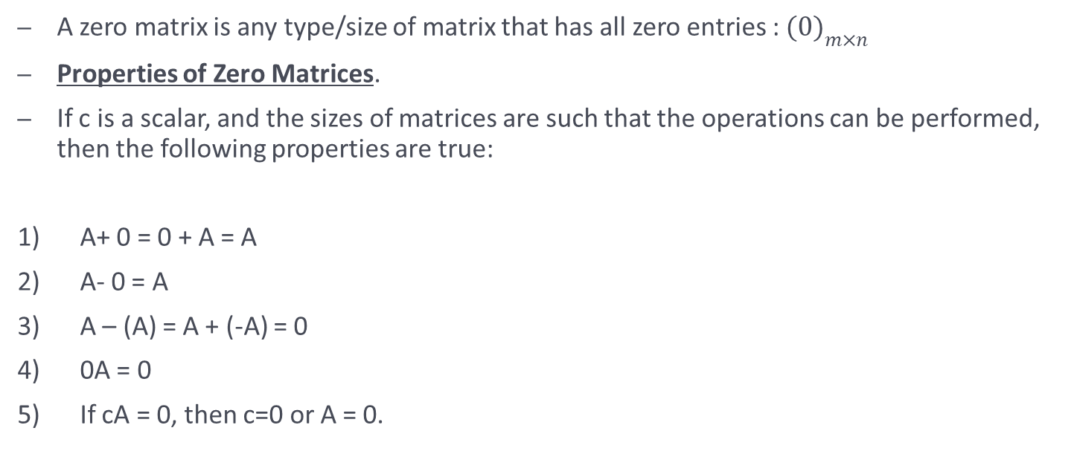
Zero matrices
A zero matrix is any type/size of matrix that has all zero entries : ${(0)}_{m×n}$
Properties of Zero Matrices.
If c is a scalar, and the sizes of matrices are such that the operations can be performed, then the following properties are true:
A+ 0 = 0 + A = A
A- 0 = A
A – (A) = A + (-A) = 0
0A = 0
If cA = 0, then c=0 or A = 0.

Slide 7
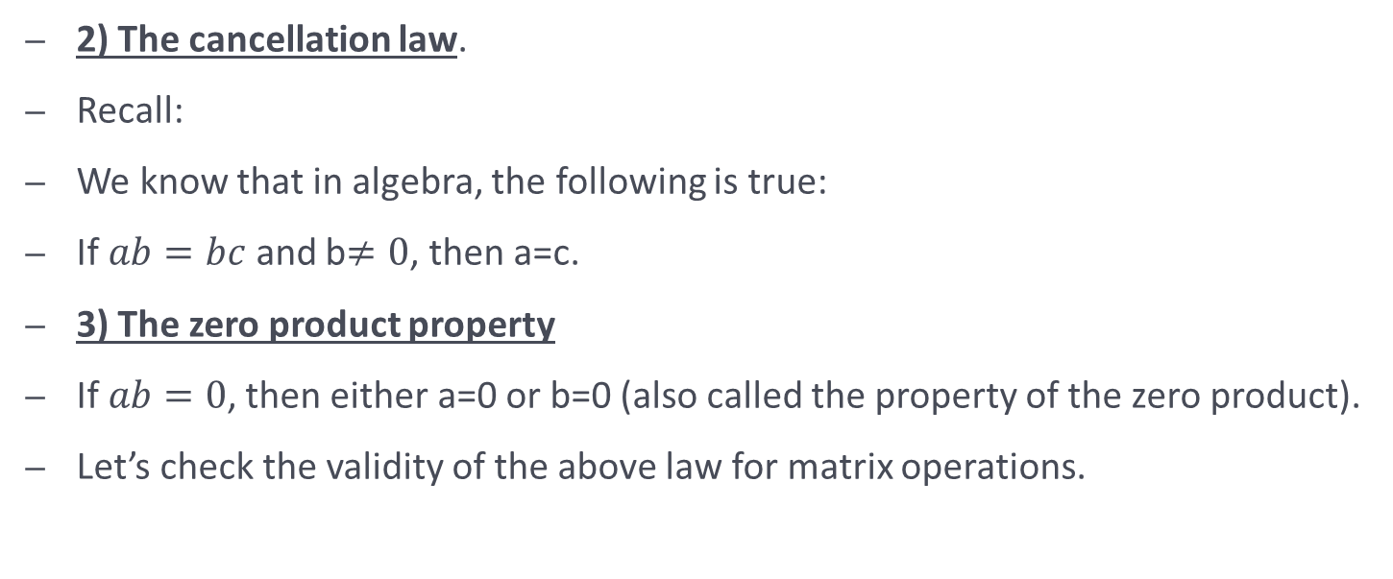
NOT TRUE for matrices - Continued
2) The cancellation law.
Recall:
We know that in algebra, the following is true:
If $ab=bc$ and b$≠0$, then a=c.
3) The zero product property
If $ab=0$, then either a=0 or b=0 (also called the property of the zero product).
Let’s check the validity of the above law for matrix operations.

Slide 8

Check the cancellation law: Given the following matrices, check if AB = AC $A=\left[\begin{aligned}0 1 \\ 0 2\end{aligned}\right]$ ; $B=\left[\begin{aligned}1 1 \\ 3 4\end{aligned}\right]$; $C=\left[\begin{aligned}2 5 \\ 3 4\end{aligned}\right]$

Slide 9
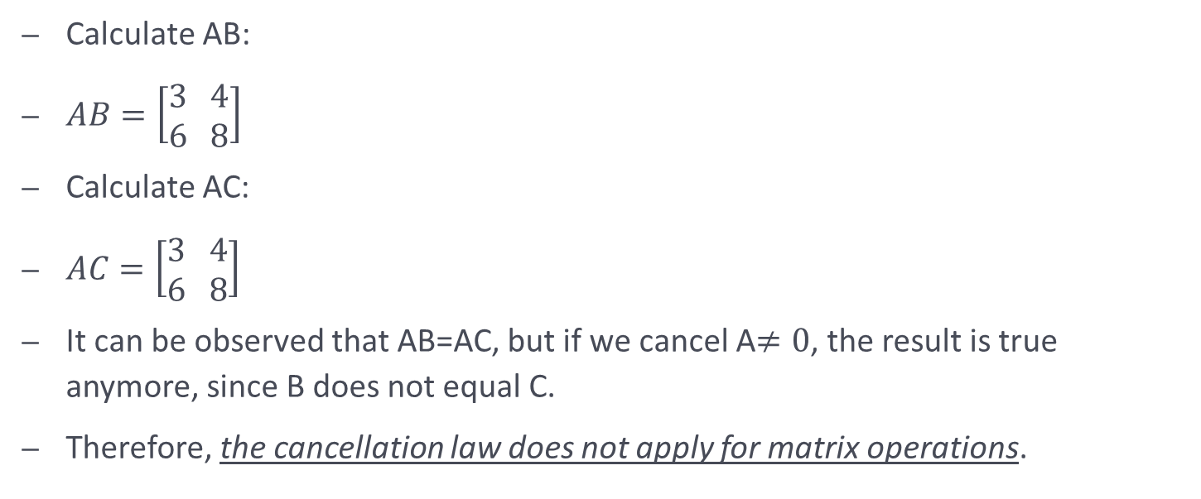
Calculate AB:
$AB=\left[\begin{aligned}3 4 \\ 6 8\end{aligned}\right]$
Calculate AC:
$AC=\left[\begin{aligned}3 4 \\ 6 8\end{aligned}\right]$
It can be observed that AB=AC, but if we cancel A$≠0$, the result is true anymore, since B does not equal C.
Therefore, the cancellation law does not apply for matrix operations.

Slide 10

Check the zero product property: Sometimes, the product of two non-zero matrices can result in a zero product.
Here is an example:
$A=\left[\begin{aligned}0 1 \\ 0 2\end{aligned}\right]$ , $B=\left[\begin{aligned}3 7 \\ 0 0\end{aligned}\right]$
It can be observed that the product of A and B is a zero matrix: $AB=0, although$
$A≠0 and B≠0)$.

Slide 11
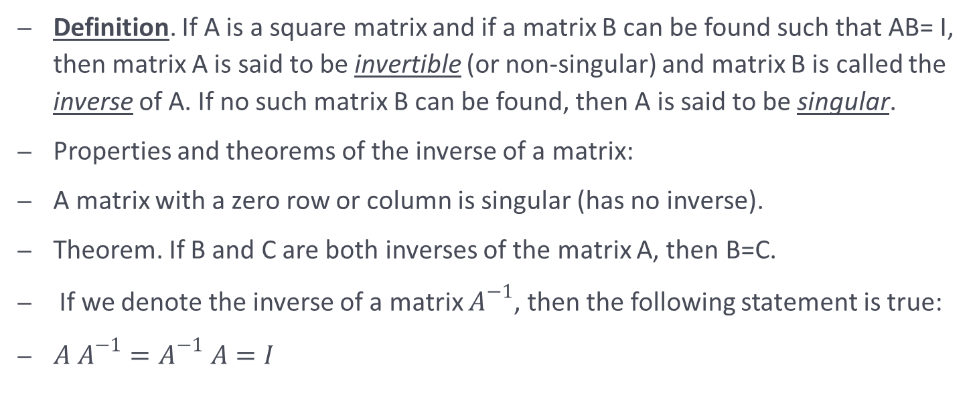
The inverse of a matrix
Definition. If A is a square matrix and if a matrix B can be found such that AB= I, then matrix A is said to be invertible (or non-singular) and matrix B is called the inverse of A. If no such matrix B can be found, then A is said to be singular.
Properties and theorems of the inverse of a matrix:
A matrix with a zero row or column is singular (has no inverse).
Theorem. If B and C are both inverses of the matrix A, then B=C.
If we denote the inverse of a matrix $A^{−1}$, then the following statement is true:
$A A^{−1}=A^{−1} A=I$

Slide 12
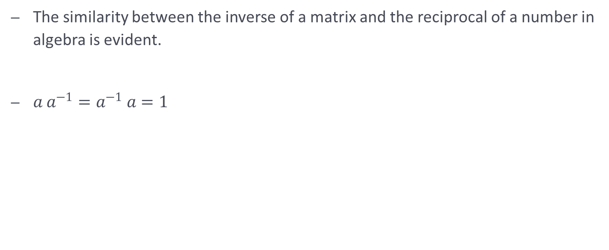
The similarity between the inverse of a matrix and the reciprocal of a number in algebra is evident.
$a a^{−1}=a^{−1} a=1$

Slide 13

Theorem. The inverse of a 2 x 2 matrix
The matrix
$$\left[\begin{aligned}a b \\ c d\end{aligned}\right]$$
is invertible if and only if $ad−bc≠0$ in which case the inverse is given by the formula
$$A^{−1}=\frac{1}{ad−bc} \left[\begin{aligned} d −b \\ −c a\end{aligned}\right]$$

Slide 14
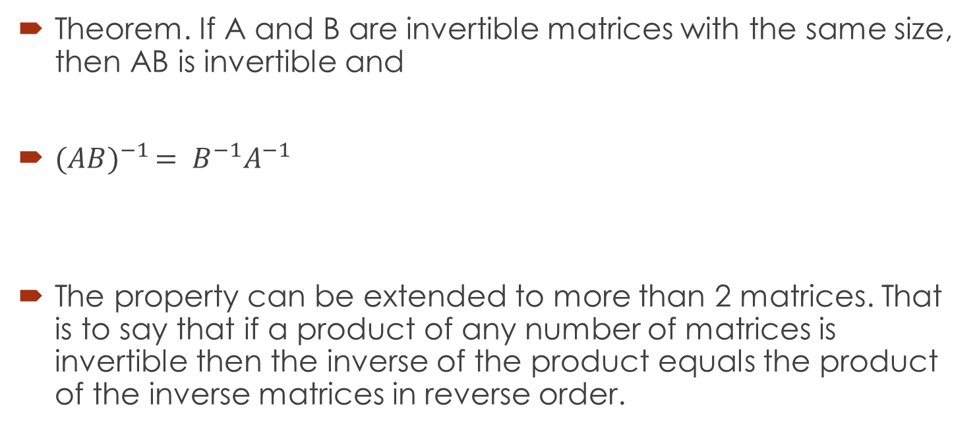
The inverse of a product
Theorem. If A and B are invertible matrices with the same size, then AB is invertible and
${(AB)}^{−1 }= B^{−1}A^{−1}$
The property can be extended to more than 2 matrices. That is to say that if a product of any number of matrices is invertible then the inverse of the product equals the product of the inverse matrices in reverse order.

Slide 15
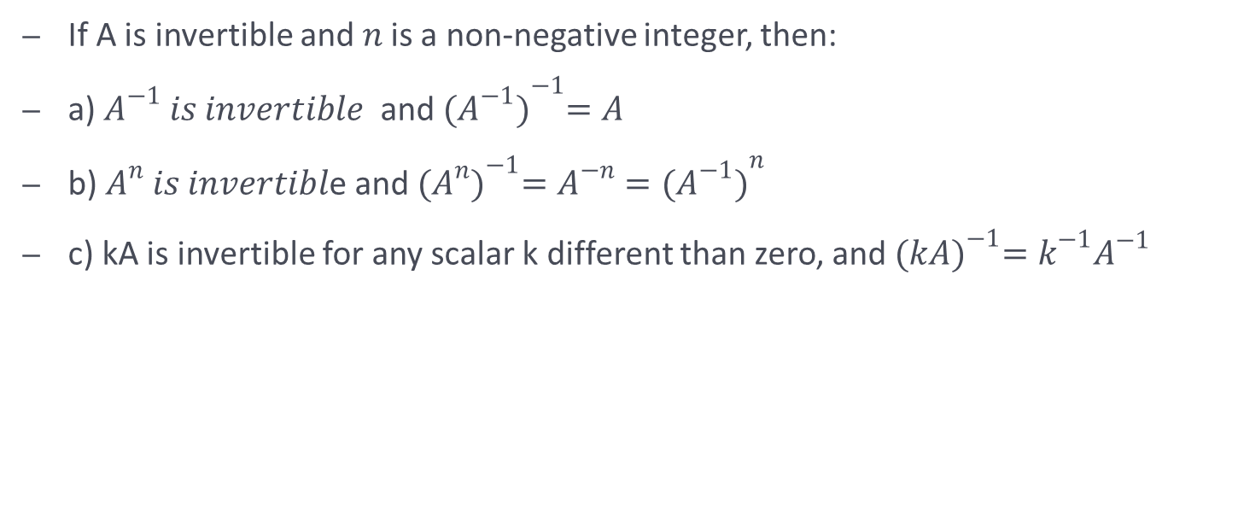
Theorem
If A is invertible and $n$is a non-negative integer, then:
a) $A^{−1} is invertible$ and ${(A^{−1})}^{−1}=A$
b) $A^{n} is invertibl$e and ${(A^{n})}^{−1}=A^{−n}={(A^{−1})}^{n}$
c) kA is invertible for any scalar k different than zero, and ${(kA)}^{−1}=k^{−1}A^{−1}$

Slide 16

Properties of transposes
If A and B are matrices whose sizes are such that the given operations are defined and c is any scalar then:
${{(A}^{T})}^{T}$= A
${(A ±B)}^{T}=A^{T}±B^{T}$
${(cA)}^{T}=cA^{T}$
${(AB)}^{T}= B^{T}A^{T}$

Slide 17

Theorem
If A is an invertible matrix, then $A^{T}$is an invertible matrix and
${{(A}^{T})}^{−1}={{(A}^{−1})}^{T}$

Slide 20

Practice
Given the following information, find A:
1. a) $A^{−1}= \left[\begin{aligned}2 0 \\ 3 1\end{aligned}\right]$
b) ¼ $×A^{−1}=\left[\begin{aligned}2 1 \\ 5 8\end{aligned}\right]$

Slide 22

${d) (A^{T})}^{−1}= \left[\begin{aligned}3 1 \\ 4 2\end{aligned}\right]$
e) ${({3A}^{T})}^{−1}=\left[\begin{aligned}−3 0 \\ 1 5\end{aligned}\right]$

Slide 24

Simplify the following expressions:
a) $(A−B){\left(A−B\right)}^{−1}C(C^{−1}+D)D^{−1}$

Slide 25

b) ${(A^{−1}B^{−1})}^{−1}A^{−1}{(C^{T}D^{T})}^{T}C^{−1}$

Slide 26

Find p(A) for the following polynomial:
$p\left(x\right)=3x^{2}−x+7$
where: $A= \left[\begin{aligned}−3 0 \\ 1 5\end{aligned}\right]$

Slide 28

Find all values of k for which:
$\left[2 2 k\right]×\left[\begin{aligned}1 2 0 \\ 2 0 3 \\ 0 3 1\end{aligned}\right]×\left[\begin{aligned}2 \\ 2 \\ k\end{aligned}\right]=0$

Slide 30

Find matrix A, given the following information:
$${(A−5 \left[\begin{aligned}1 −1 0 \\ 1 2 4\end{aligned}\right])}^{T}= \left[\begin{aligned}2 1 \\ 0 5 \\ 3 8\end{aligned}\right]$$

Slide 32

Find x and y if $2A−B=I, where A= \left[\begin{aligned}−2 1 \\ 0 3\end{aligned}\right]; B= \left[\begin{aligned}x 2 \\ y 5\end{aligned}\right]$

Slide 33

Let A and B be these matrices:
A = $\left[\begin{aligned}3 5 \\ 1 2\end{aligned}\right]$; B = $\left[\begin{aligned}2 −5 \\ −1 3\end{aligned}\right]$
Are A and B inverses of each other?

Slide 34

If $A^{−1}=\left[\begin{aligned}6 1 \\ 4 3\end{aligned}\right]$ and $A\left[\begin{aligned}x1 \\ x2\end{aligned}\right]= \left[\begin{aligned}2 \\ 1\end{aligned}\right]$, what are the values of x1 and x2?

Slide 35

Suppose:
$A=\left[\begin{aligned}1 −2 \\ −2 5\end{aligned}\right]$ and A B = $\left[\begin{aligned}−1 2 −1 \\ 6 −9 3\end{aligned}\right]$.
Find matrix B.

Slide 37
Solve the equation A B = B C for A, assuming that A , B and C are square matrices and B is invertible.

Slide 38

Suppose P is invertible and $A=P B P^{−1}$. Solve for B in terms of A.

Slide 39

Given matrix A, show that ${{(A}^{T})}^{−1}={{(A}^{−1})}^{T}$
A = $\left[\begin{aligned}4 −5 \\ 2 1\end{aligned}\right]$

